Slide 1
The Fundamental Traffic Diagram

Slide 2
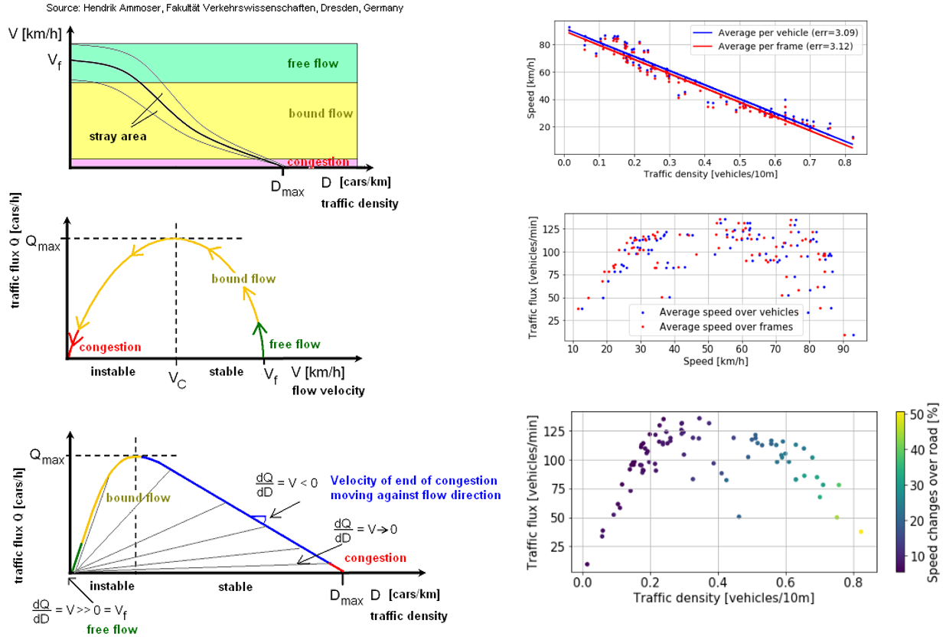
The Fundamental Traffic Diagram
Theoretical
Empirical

